Slide 1
Inferring causality in time series
Martin Sliacky

Slide 2
Table of contents

Slide 3
Causality vs correlation

Slide 4
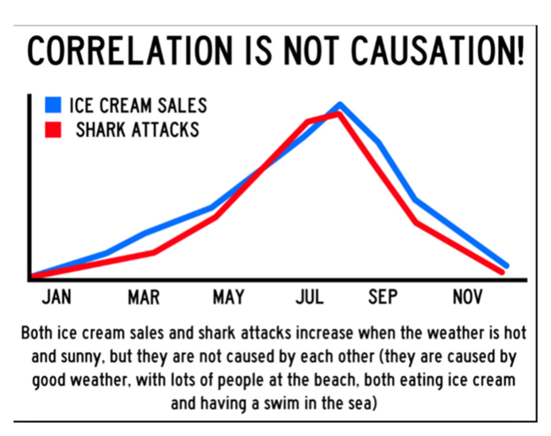
Correlation
measure of linear dependence between two random variables
Symmetric relationship
Measured via various correlation coefficients

Slide 5
What is causality?

Slide 6
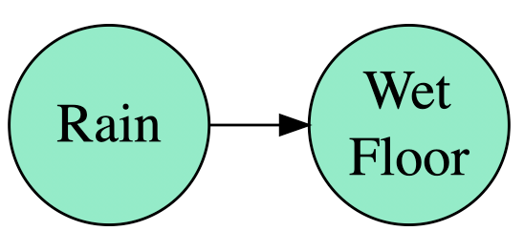
Causality
Relationship between cause and effect
Conditions:
Correlation between a cause and its effect
Cause chronologically precedes the effect
Correlation is still present when we remove all confounding (extraneous) variables

Slide 7
Can we really infer causality?

Slide 8
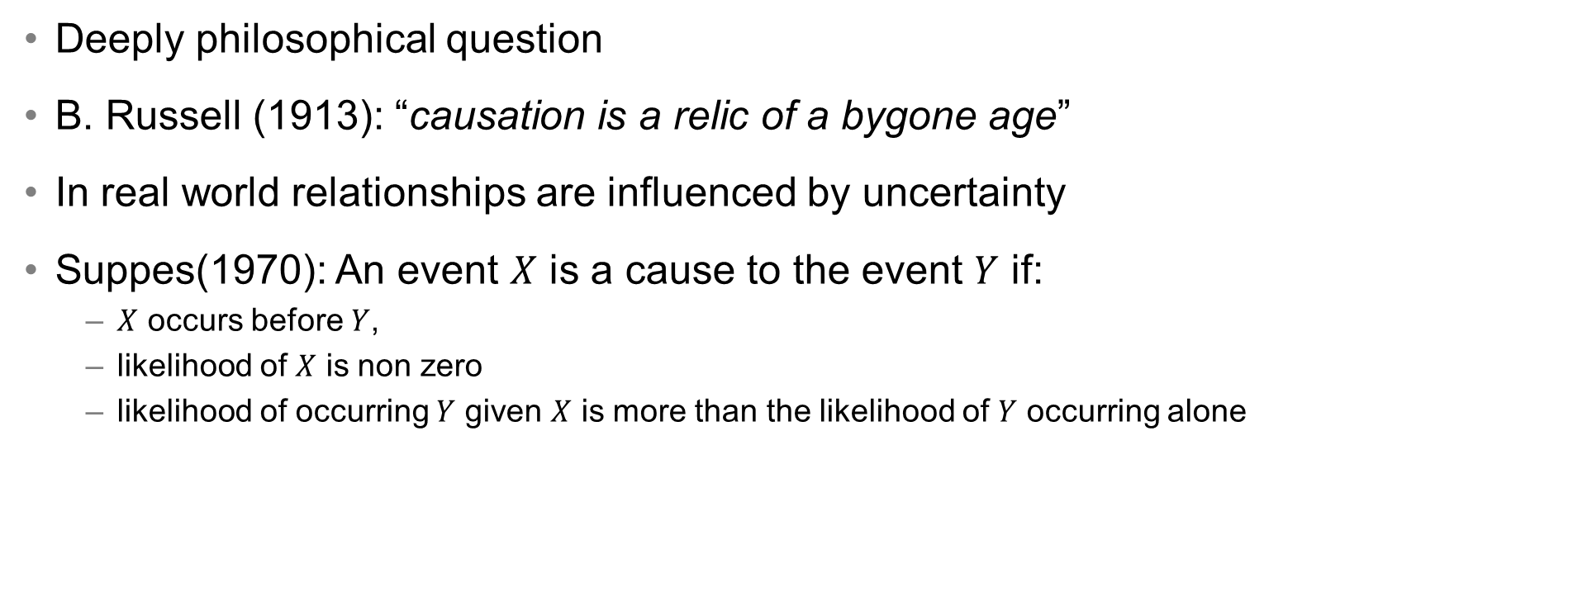
Can we really infer causality
Deeply philosophical question
B. Russell (1913): “causation is a relic of a bygone age”
In real world relationships are influenced by uncertainty
Suppes(1970): An event $X$ is a cause to the event $Y$ if:
$X$ occurs before $Y$,
likelihood of $X$ is non zero
likelihood of occurring $Y$ given $X$ is more than the likelihood of $Y$ occurring alone

Slide 9
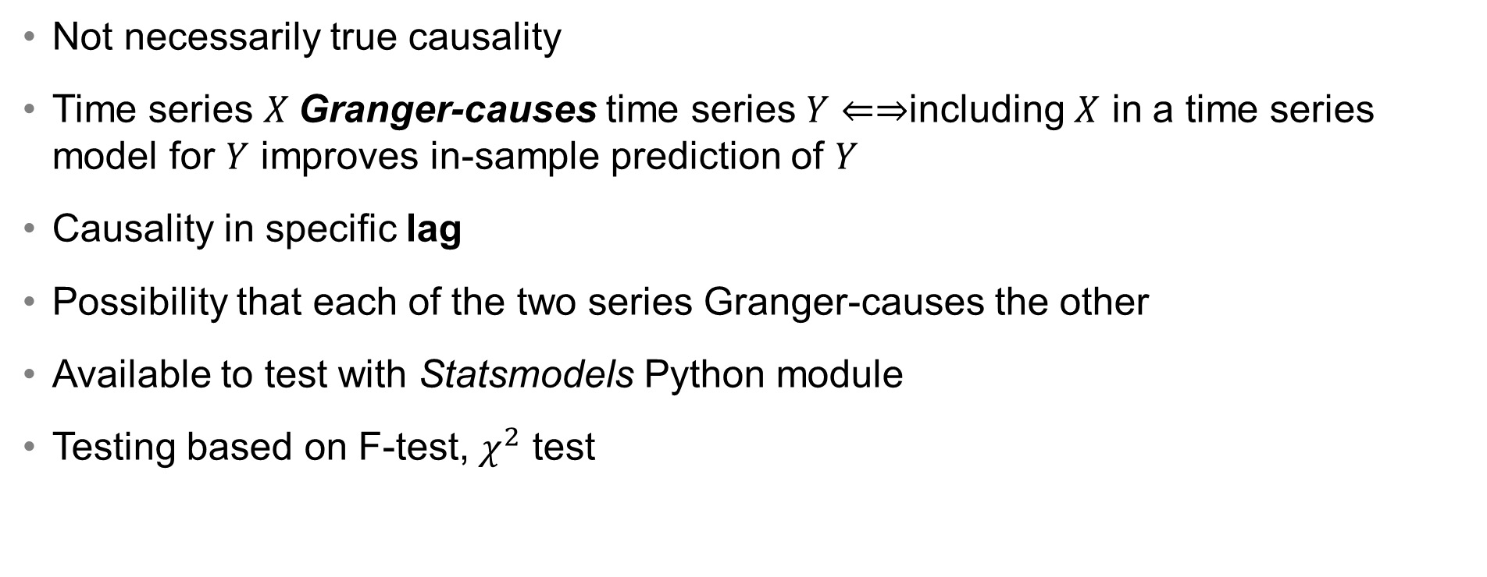
Granger causality
Not necessarily true causality
Time series $X$Granger-causes time series $Y⇐⇒$including $X$ in a time series model for $Y$ improves in-sample prediction of $Y$
Causality in specific lag
Possibility that each of the two series Granger-causes the other
Available to test with Statsmodels Python module
Testing based on F-test, $χ^{2}$ test

Slide 10
Business problem
1. Does change in our product pricing “cause” competitor to change the price of theirs?
Make predictive model based on some features (correlations)
We may find out that change in our price can predict competitor’s price
Would decreasing our price decrease competitor’s price?
???

Slide 11
Possible explanations
1.
Dell price decrease
Competitor’s price decrease
2.
Dell price decrease
Competitor’s price decrease
External factor
3.
Dell price decrease
Competitor’s price decrease

Slide 12
Counterfactual questions
2. Counterfactual question: Would competitor decreased the price anyway, without the decrease on our side?
Typically models are good at predicting the original question (because we have data available) but not at predicting the counterfactual

Slide 13
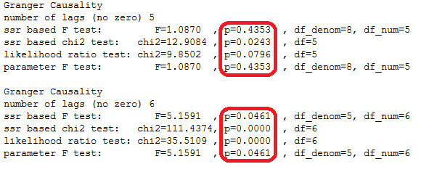

Granger causality
$H_{0}:\text{X} \text{does} \text{not} \text{Granger}\text{−}\text{cause} \text{Y}$
$H_{A}:\text{X} \text{does} \text{Granger}\text{−}\text{cause} \text{Y}$

Slide 15
Causal graphs

Slide 16
Interpolation of missing values

Slide 19
Measures of causality

Slide 20
Measures of causality
Chaos and dynamic systems theory based
Multispatial convergent cross mapping (also for short series)
multispatialCCM package in R (successfully detected causal relationship in series of 5 observations)
Information theory (entropy) based
(Conditional) mutual information
Transfer entropy
RTransferEntropy package https://cran.r-project.org/web/packages/RTransferEntropy/vignettes/transfer-entropy.html
Variable-Lag Time Series Causality Inference
Suitable for non-stationary time series
https://cran.r-project.org/web/packages/VLTimeCausality/index.html

Slide 21
Causal graphs

